Slide 1
Name of the Institute – SBB College of Physiotherapy
Name of the Department – Pediatric Rehabilitation Department
Address – SBB College of Physiotherapy, V S Hospital & SVP Hospital Campus, Ellisbridge, Ahmedabad -380006
Contact number – 079-26583435
Timing – 9.00 am to 1.00 pm

Slide 2
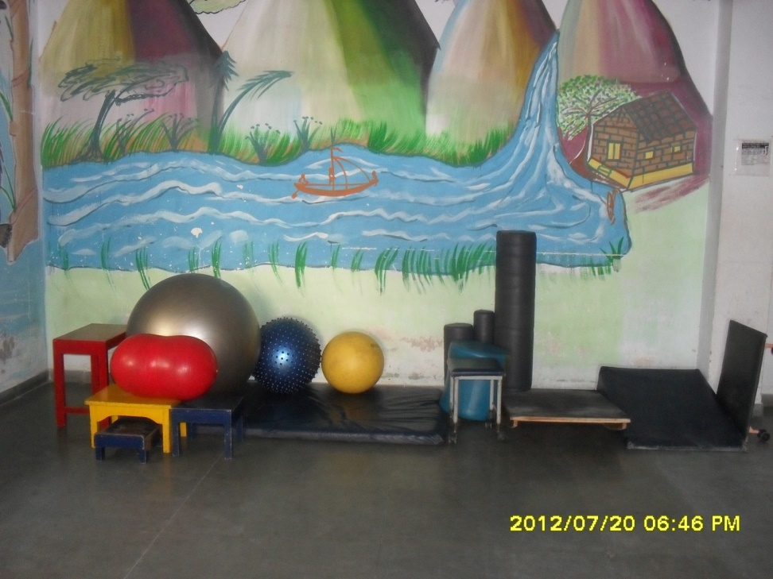

Slide 3
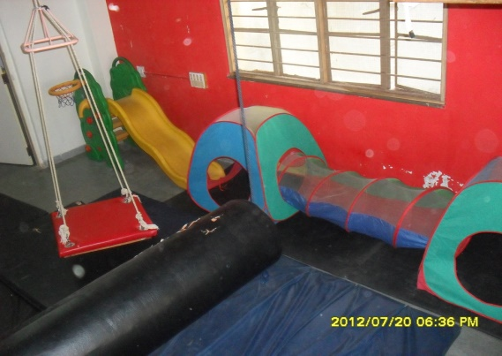

Slide 4
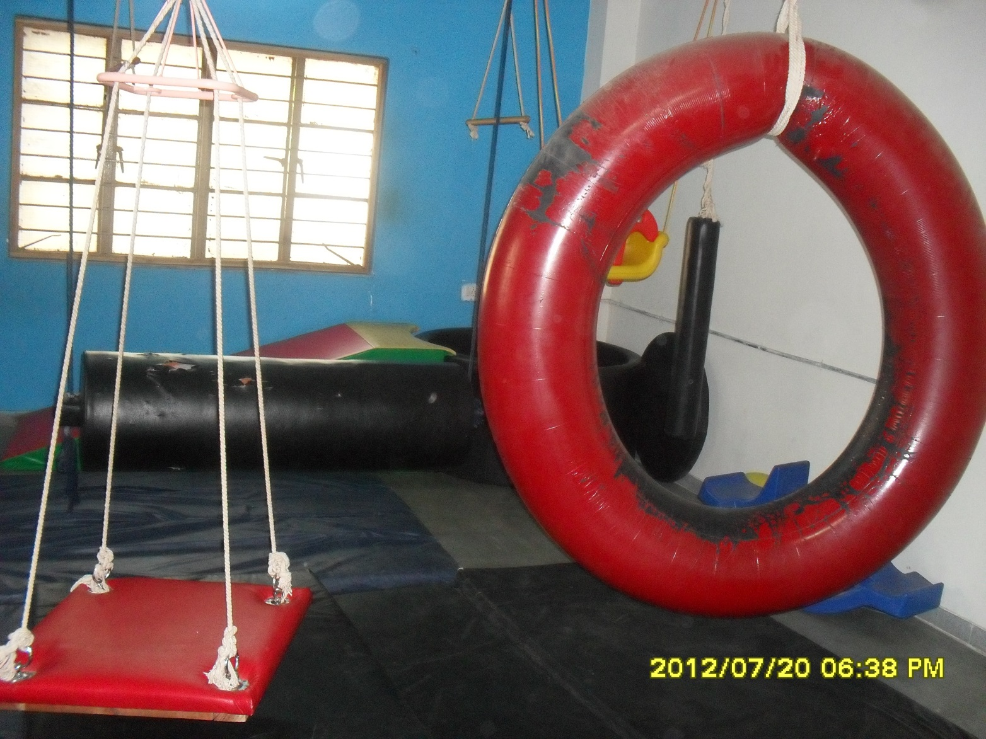

Slide 5
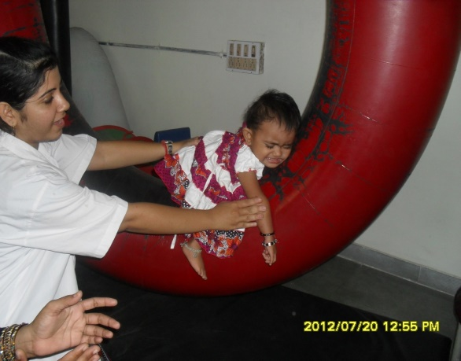

Slide 6
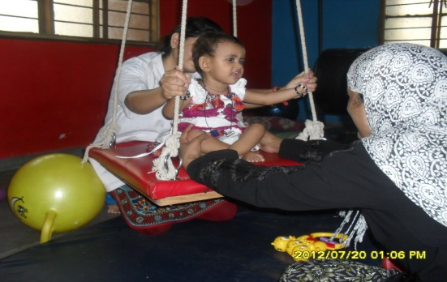

Slide 7
